Slide 1
N. Rizk
COSC 2430 : Data Structures
College of Natural and Applied Sciences
Department of Computer Science
University of Houston

Slide 2
Data structures and algorithms are the fundamentals of programming. In order to become a good developer it is essential to master the basic data structures and
algorithms and learn to apply them in the right way.
Algorithm + Data structure
=
Program

Slide 3
An algorithm is said to be efficient and fast, if it takes less time to execute and consumes less memory space.
The performance of an algorithm is measured on the basis of following properties :
Space Complexity
Time Complexity

Slide 4
Constant Space Complexity
int square(int a)
{
return a*a;
}
If any algorithm requires a fixed amount of space for all input values then that space complexity is said to be Constant Space Complexity

Slide 5
Linear Space Complexity
int sum(int A[], int n)
{
int sum = 0, i;
for(i = 0; i < n; i++)
sum = sum + A[i];
return sum;
}
If the amount of space required by an algorithm is increased with the increase of input value, then that space complexity is said to be Linear Space Complexity

Slide 6
TIME COMPLEXITY
The time complexity of an algorithm is the total amount of time required by an algorithm to complete its execution.
If any program requires fixed amount of time for all input values then its time complexity is said to be Constant Time Complexity
int sum(int a, int b)
{
return a+b;
}

Slide 7
Linear Time Complexity
If the amount of time required by an algorithm is increased with
the increase of input value then that time complexity
is said to be Linear Time Complexity
int sum(int A[], int n)
{
int sum = 0, i;
for(i = 0; i < n; i++) sum = sum + A[i];
return sum;
}

Slide 8
O
How you can change the world
by learning Data Structures and Algorithms

Slide 9
A problem you all know how to solve: Integer Multiplication
12
34
x
Notes:
(Do out this multiplication on the board)

Slide 10
A problem you all know how to solve: Integer Multiplication
1234567895931413
4563823520395533
x

Slide 11
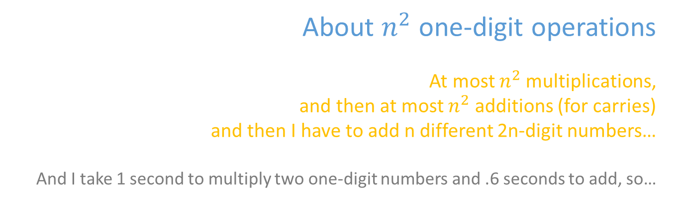
A problem you all know how to solve: Integer Multiplication
n
1233925720752752384623764283568364918374523856298
4562323582342395285623467235019130750135350013753
x
???
About $n^{2}$one-digit operations
At most $n^{2}$multiplications,
and then at most $n^{2}$ additions (for carries)
and then I have to add n different 2n-digit numbers…
And I take 1 second to multiply two one-digit numbers and .6 seconds to add, so…
How would you solve this problem?
How long would it take you?

Slide 12

The algorithm designer’s question
Algorithm design is both an art and a science.
Can I do better?
Algorithm designer

Slide 13
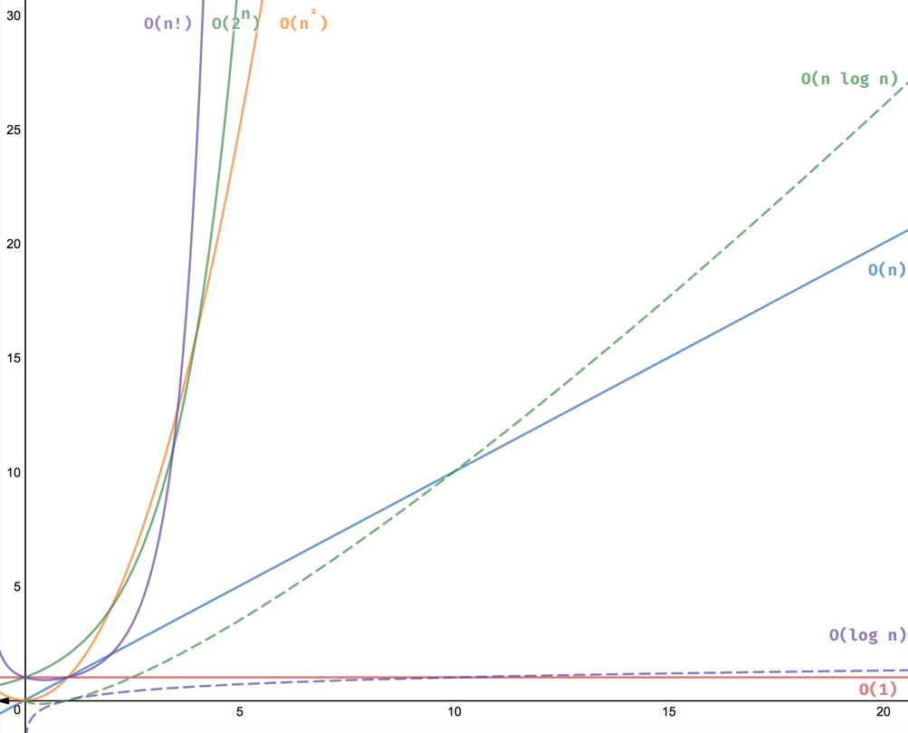

Slide 14
Growth of Functions
Although we can sometimes determine the exact running time of an algorithm, the extra precision is not usually worth the effort of computing it.
For large inputs, the multiplicative constants and lower order terms of an exact running time are dominated by the effects of the input size itself.

Slide 15
Asymptotic Notation
The notation we use to describe the asymptotic running time of an algorithm are defined in terms of functions whose domains are the set of natural numbers
N = {0, 1, 2, ...}

Slide 16
Time complexity = Running time
Asymptotic analysis: Asymptotic analysis is just evaluating functions as their value approximate to the infinite
Worst-case time complexity (e.g., input elements in reversed order)
Best-case time complexity (e.g., already sorted)
Average-case time complexity (e.g., elements in random order)
The Big O notation combines worst-case time complexity and asymptotic analysis.
The letter O refers to the order of a function
==upper bound of the growth rate of a function.
n | O(1) | O(log n) | O(n) | O(nlogn) | O(n²) | O(2^{n}) | O(n!)

Slide 17
O-notation
For a given function g(n), we denote by O(g(n))
the set of functions
⎧
f (n) :there exist positive constants c and n s.t.
⎫
O(g(n)) =
⎨
0
⎬
⎩
0 ≤ f (n) ≤ cg(n) for all n ≥ n
⎭
0
We use O-notation to give an asymptotic upper bound on a function, to within a constant factor.

Slide 18
Θ-notation
For a given function g(n), we denote by Θ(g(n))
the set of functions
⎧
f (n) :there exist positive constants c , c , and n s.t.
⎫
Θ(g(n)) =
⎨
1 2 0
⎬
⎩
0 ≤ c₁g(n) ≤ f (n) ≤ c₂ g(n) for all n ≥ n₀
⎭
A function f (n) belongs to the set Θ(g(n)) if
c₁
there exist positive constants and c2 such
that it can be “sandwiched” between c1g(n) and
c₂ g(n)
for sufficienly large n.

Slide 19
Ω-notation
For a given function g(n), we denote by Ω(g(n))
the set of functions
⎧
f (n) :there exist positive constants c and n s.t.
⎫
Ω(g(n)) =
⎨
0
⎬
⎩
0 ≤ cg(n) ≤ f (n) for all n ≥ n
⎭
0
We use O-notation to give an asymptotic lower bound on a function, to within a constant factor.

Slide 20
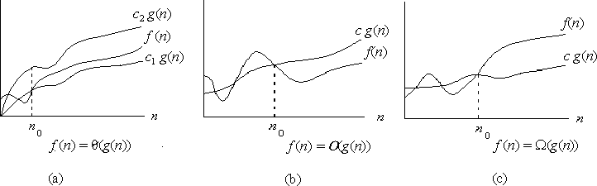
Asymptotic notation
Graphic examples of Θ, O, and Ω .

Slide 21
Example
Show that
f (n) = ¹ n² − 3n = Θ(n² )
2
We must find c₁ and c₂ such that
c₁n² ≤ ¹ n² − 3n ≤ c₂n²
2
Dividing bothsides by n² yields
c₁ ≤ ¹ − ³ ≤ c₂
2 n
For
n₀ ≥ 7
¹ n² − 3n = Θ(n² )
2

Slide 22
Theorem
For any two functions f (n) and
f (n) = Θ(g(n))
g(n), we have
if and only if
f (n) = O(g(n)) and f (n) = Ω(g(n)).

Slide 23
Example
f (n) = 3n ² − 2n + 5 = Θ(n ² )
3n ² − 2n + 5 = Ω(n ² )
3n ² − 2n + 5 = O(n ² )

Slide 24
o-notation
We use o-notation to denote an upper bound that is not asymptotically tight.
We formally define
o(g(n)) as the set
⎧ f (n) : for any positive constant c > 0
⎫
⎪
o(g(n)) = ⎪ there exist a constants n > 0 s.t.⎬
⎨
⎪⎩
0
0 ≤ f (n) ≤ cg(n) for all n ≥ n₀
⎪⎭
lim
f (n) ₌ ₀
_{n →∞} g(n)

Slide 25
ω-notation
We use ω-notation to denote an upper bound that is not asymptotically tight.
We formally define ω(g(n)) as the set
⎧ f (n) : for any positive constant c > 0
⎫
⎪
ω(g(n)) = ⎪
there exist a constants n > 0 s.t.⎬
⎨
⎪⎩
0
0 ≤ cg(n) ≤ f (n) for all n ≥ n₀
⎪⎭
lim
f (n) _{= ∞}
_{n →∞} g(n)

Slide 26
Big O Notation | Name | Example(s)
O(1) | Constant | # Odd or Even number, # Look-up table (on average)
O(log n) | Logarithmic | # Finding element on sorted array with binary search
O(n) | Linear | # Find max element in unsorted array, # Duplicate elements in array with Hash Map
O(n log n) | Linearithmic | # Sorting elements in array with merge sort
O(n²) | Quadratic | # Duplicate elements in array **(naïve)**, # Sorting array with bubble sort
O(n³) | Cubic | # 3 variables equation solver
O(2^{n}) | Exponential | # Find all subsets
O(n!) | Factorial | # Find all permutations of a given set/string

Slide 27
Example: Polynomial Evaluation
Suppose that exponentiation is carried out using multiplications. Two ways to evaluate the polynomial
p(x) = 4x⁴ + 7x³ – 2x² + 3x¹ + 6
are:
Brute force method:
p(x) = 4*x*x*x*x + 7*x*x*x – 2*x*x + 3*x + 6
Horner’s method:
p(x) = (((4*x + 7) * x – 2) * x + 3) * x + 6

Slide 28
Example: Polynomial Evaluation
Method of analysis:
Basic operations are multiplication, addition, and subtraction
We’ll only consider the number of multiplications, since the number of additions and subtractions are the same in each solution
We’ll examine the general form of a polynomial of degree n, and express our result in terms of n
We’ll look at the worst case (max number of multiplications) to get an upper bound on the work

Slide 29
Example: Polynomial Evaluation
General form of polynomial is
p(x) = a_{n}x^{n} + a_{n-1}x^{n-1} + a_{n-2}x^{n-2} + … + a₁x¹ + a₀
where a_{n} is non-zero for all n >= 0

Slide 30
Example: Polynomial Evaluation
Analysis for Brute Force Method:
p(x) = a_{n} * x * x * … * x * x + n multiplications
a _{n-1} * x * x * … * x * x + n-1 multiplications
a _{n-2} * x * x * … * x * x + n-2 multiplications
… + …
a₂ * x * x + 2 multiplications
a₁ * x + 1 multiplication
a₀

Slide 31
Example: Polynomial Evaluation
Number of multiplications needed in the worst case is
T(n) = n + n-1 + n-2 + … + 3 + 2 + 1
= n(n + 1)/2 (result from high school math **)
= n²/2 + n/2
This is an exact formula for the maximum number of multiplications. In general though, analyses yield upper bounds rather than exact formulae. We say that the number of multiplications is on the order of n², or O(n²). (Think of this as being proportional to n².)

Slide 32
Example: Polynomial Evaluation
Analysis for Horner’s Method:
p(x) = ( … ((( a_{n} * x + 1 multiplication
a_{n-1}) * x + 1 multiplication
a_{n-2}) * x + 1 multiplication
… + n times
a₂) * x + 1 multiplication
a₁) * x + 1 multiplication
a₀
T(n) = n, so the number of multiplications is O(n)

Slide 33
Example: Polynomial Evaluation
n (Horner) | n²/2 + n/2 (brute force) | n²
5 | 15 | 25
10 | 55 | 100
20 | 210 | 400
100 | 5050 | 10000
1000 | 500500 | 1000000

Slide 34
Example: Polynomial Evaluation
600
500
f(n) = n²
T(n) = n²/2 + n/2
400
# of mult’s
300
200
100
g(n) = n
5
10
15
20
25
30
35
n (degree of polynomial)

Slide 35
Sum of First n Natural Numbers
Write down the terms of the sum in forward and reverse orders; there are n terms:
T(n) = 1 + 2 + 3 + … + (n-2) + (n-1) + n
T(n) = n + (n-1) + (n-2) + … + 3 + 2 + 1
Add the terms in the boxes to get:
2*T(n) = (n+1) + (n+1) + (n+1) + … + (n+1) + (n+1) + (n+1)
= n(n+1)
Therefore, T(n) = (n*(n+1))/2 = n²/2 + n/2

Slide 36
Big-O Notation
Formally, the time complexity T(n) of an algorithm is O(f(n)) (of the order f(n)) if, for some positive constants C1 and C2 for all but finitely many values of n
C1*f(n) ≤ T(n) ≤ C2*f(n)
This gives upper and lower bounds on the amount of work done for all sufficiently large n

Slide 37
Big-O Notation
Example: Brute force method for polynomial evaluation: We chose the highest-order term of the expression T(n) = n²/2 + n/2, with a coefficient of 1, so that f(n) = n².
T(n)/n² approaches 1/2 for large n, so T(n) is approximately n²/2.
n²/2 <= T(n) <= n²
so T(n) is O(n²).

Slide 38
Big-O Notation
We want an easily recognized elementary function to describe the performance of the algorithm, so we use the dominant term of T(n): it determines the basic shape of the function

Slide 39
Worst Case vs. Average Case
Worst case analysis is used to find an upper bound on algorithm performance for large problems (large n)
Average case analysis determines the average (or expected) performance
Worst case time complexity is usually simpler to work out

Slide 40
Big-O Analysis in General
With independent nested loops: The number of iterations of the inner loop is independent of the number of iterations of the outer loop
Example:
int x = 0;
for ( int j = 1; j <= n/2; j++ )
for ( int k = 1; k <= n*n; k++ )
x = x + j + k;
Outer loop executes n/2 times. For each of those times, inner loop executes n² times, so the body of the inner loop is executed (n/2)*n² = n³/2 times. The algorithm is O(n³) .

Slide 41
Big-O Analysis in General
With dependent nested loops: Number of iterations of the inner loop depends on a value from the outer loop
Example:
int x = 0;
for ( int j = 1; j <= n; j++ )
for ( int k = 1; k < 3*j; k++ )
x = x + j;
When j is 1, inner loop executes 3 times; when j is 2, inner loop executes 3*2 times; … when j is n, inner loop executes 3*n times. In all the inner loop executes 3+6+9+…+3n = 3(1+2+3+…+n) = 3n²/2 + 3n/2 times. The algorithm is O(n²).

Slide 42
Big-O Analysis in General
Assume that a computer executes a million instructions a second. This chart summarizes the amount of time required to execute f(n) instructions on this machine for various values of n.
f(n) | n=10³ | n=10⁵ | n=10⁶
log₂(n) | 10⁻⁵ sec | 1.7 * 10⁻⁵ sec | 2 * 10⁻⁵ sec
n | 10⁻³ sec | 0.1 sec | 1 sec
n*log₂(n) | 0.01 sec | 1.7 sec | 20 sec
n² | 1 sec | 3 hr | 12 days
n³ | 17 min | 32 yr | 317 centuries
2^{n} | 10²⁸⁵ centuries | 10¹⁰⁰⁰⁰ years | 10¹⁰⁰⁰⁰⁰ years

Slide 43
O(1) - Constant time
function isEvenOrOdd(n) {
return n % 2 ? 'Odd' : 'Even';
}
It doesn’t matter if n is 10 or 10,001, it will execute line 2 one time
function lookup(dictionary, word) {
return dictionary[word];
}
if the dictionary has 10 or 1 million words, it would still execute line 4 once to find the word

Slide 44
O(log n) - Logarithmic time
When analyzing recursive algorithms:
The runtime of the work done outside the recursion O(1)
How many recursive calls the problem is divided : 1 recursive call. Notice only one or the other will happen, never both.
How much n is reduced on each recursive call 1/2. Every recursive call cuts n in half.
T(n) = a T(n/b) + f(n)
where:
T: time complexity function in terms of the input size n.
n: the size of the input. duh? :)
a: the number of sub-problems. For our case, we only split the problem into one subproblem. So, a=1.
b: the factor by which n is reduced. For our example, we divide n in half each time. Thus, b=2.
f(n): the running time outside the recursion. Since dividing by 2 is constant time, we have f(n) = O(1).
2) Once we know the values of a, b and f(n). We can determine the runtime of the recursion using this formula:
O(log(n))

Slide 45
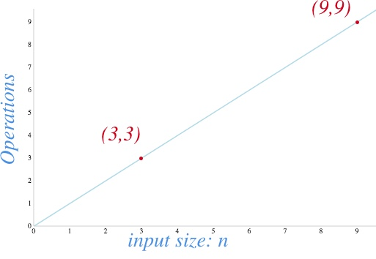
O(n) - Linear time
function findMax(n) {
let max;
let counter = 0;
for (let i = 0; i < n.length; i++) {
counter++;
if(max === undefined || max < n[i])
max = n[i]; }
return max;
}
2 operations
n times
3 operations
1 operation
====➔ total =2+3n+1

Slide 46
O(n log n) - Linearithmic
Let’s find the values of: T(n) = a T(n/b) + f(n)
a: The number of sub-problems is 2 So, a = 2.
b: Each of the sub-problems divides n in half. So, b = 2
f(n): The work done outside the recursion is the function merge, which has a runtime of O(n) since it visits all the elements on the given arrays.
Substituting the values:
T(n) = 2 T(n/2) + O(n)

Slide 47
O(n^2) - Quadratic time
Check if a collection has duplicated values.
Sorting items in a collection using bubble sort, insertion sort, or selection sort.
Find all possible ordered pairs in an array.
function sort(n) {
for (let outer = 0; outer < n.length; outer++) {
let outerElement = n[outer];
for (let inner = outer + 1; inner < n.length; inner++) {
let innerElement = n[inner];
if(outerElement > innerElement) {
// swap
n[outer] = innerElement;
n[inner] = outerElement;
// update references
outerElement = n[outer];
innerElement = n[inner]; } } }
return n;
}

Slide 48
O(n^c) - Polynomial time
function findXYZ(n) {
const solutions = [];
for(let x = 0; x < n; x++) {
for(let y = 0; y < n; y++) {
for(let z = 0; z < n; z++) {
if( 3*x + 9*y + 8*z === 79 ) {
solutions.push({x, y, z});
}
}
}
}
return solutions;
}

Slide 49
O(2^n) - Exponential time
function powerset(n = '') {
const array = Array.from(n);
const base = [''];
const results = array.reduce((previous, element) => {
const previousPlusElement = previous.map(el => {
return `${el}${element}`;
});
return previous.concat(previousPlusElement);
}, base);
return results;
}

Slide 50
O(n!) - Factorial time
Permutations
How would you solve that?
A straightforward way will be to check if the string has a length of 1 if so, return that string since you can’t arrange it differently.
For strings with a length bigger than 1, we could use recursion to divide the problem into smaller problems until we get to the length 1 case. We can take out the first character and solve the problem for the remainder of the string until we have a length of 1.

Slide 51
Assume that lists are implemented using an array. For each of the following List methods, say whether (in the worst case) the number of operations is independent of the size of the list (is a constant-time method), or is proportional to the size of the list (is a linear-time method):
the constructor
add (to the end of the list)
add (at a given position in the list)
isEmpty
get
constructor: constant-time.
add (to the end of the list )a constant-time operation
add (at a given position in the list takes time proportional to the
number of items in the list.
isEmpty: constant time operation.
get: constant-time operation.

Slide 52
Determining whether anyone in the room has the same birthday as you
Algorithm 1: You say your birthday, and ask whether anyone in the room has the same birthday. If anyone does have the same birthday, they answer yes.
Algorithm 2: You tell the first person your birthday, and ask if they have the same birthday; if they say no, you tell the second person your birthday and ask whether they have the same birthday; etc, for each person in the room.
Algorithm 3: You only ask questions of person 1, who only asks questions of person 2, who only asks questions of person 3, etc. You tell person 1 your birthday, and ask if they have the same birthday; if they say no, you ask them to find out about person 2. Person 1 asks person 2 and tells you the answer. If it is no, you ask person 1 to find out about person 3. Person 1 asks person 2 to find out about person 3, etc.

Slide 53
Question 1: For each algorithm, what is the factor that can affect the number of questions asked ?
The problem size is the number of people in the room.
Question 2: In the worst case, how many questions will be asked for each of the three algorithms?
In algorithm 1 you always ask 1 question. In algorithm 2, the worst case is if no one has your birthday. Here you have to ask every person to figure this out. This is N questions. In algorithm 3, the worst case is the same as algorithm 2. The number of questions is 1 + 2 + 3 + ... + N-1 + N. We showed before that this sum is N(N+1)/2.
Question 3: For each algorithm, say whether it is constant, linear, or quadratic in the problem size in the worst case.
Given the number of questions you can see that algorithm 1 is constant time, algorithm 2 is linear time, and algorithm 3 is quadratic time in the problem size.

Slide 54
What is the worst-case complexity of the each of the following code fragments?
Two loops in a row:
for (i = 0; i < N; i++) {
sequence of statements
}
for (j = 0; j < M; j++) {
sequence of statements
}
The first loop is O(N) and the second loop is O(M). Since you don't know which is bigger, you say this is O(N+M).
This can also be written as O(max(N,M)). In the case where the second loop goes to N instead of M the complexity is O(N).
You can see this from either expression above. O(N+M) becomes O(2N) and when you drop the constant it is O(N). O(max(N,M)) becomes O(max(N,N)) which is O(N).

Slide 55
How would the complexity change if the second loop went to N instead of M?
A nested loop followed by a non-nested loop:
for (i = 0; i < N; i++) {
for (j = 0; j < N; j++) {
sequence of statements
}
}
for (k = 0; k < N; k++) {
sequence of statements
}
The first set of nested loops is O(N²) and the second loop is O(N). This is O(max(N²,N)) which is O(N²).

Slide 56
A nested loop in which the number of times the inner loop executes depends on the value of the outer loop index:
for (i = 0; i < N; i++) {
for (j = N; j > i; j--) {
sequence of statements
}
}
The number of iterations of the inner loop depends on the value of the index of the outer loop.
The only difference is that in this example the inner-loop index is counting down from N to i+1. It is still the case that the inner loop executes N times, then N-1, then N-2, etc, so the total number of times the innermost "sequence of statements" executes is O(N²).

Slide 57
Given
f(k); // O(1)
g(k); // O(k) What is Big O of the code snippet below?
Each call to f(j) is O(1). The loop executes N times so it is N x O(1) or O(N).
for (j = 0; j < N; j++)
f(j);
2.The first time the loop executes j is 0 and g(0) takes "no operations". The next time j is 1 and g(1) takes 1 operations. The last time the loop executes j is N-1 and g(N-1) takes N-1 operations. The total work is the sum of the first N-1 numbers and is O(N²).
2. for (j = 0; j < N; j++) g(j);
3. for (j = 0; j < N; j++)
g(k);
3. Each time through the loop g(k) takes k operations and the loop executes N times. Since you don't know the relative size of k and N, the overall complexity is O(N x k).

Slide 58
Big O, Little O, Omega & Theta
Big O: “f(n) is O(g(n))” iff for some constants c and N₀, f(N) ≤ cg(N) for all N > N₀
Omega: “f(n) is Ω(g(n))” iff for some constants c and N₀, f(N) ≥ cg(N) for all N > N₀
Theta: “f(n) is Θ(g(n))” iff f(n) is O(g(n)) and f(n) is Ω(g(n))
Little O: “f(n) is o(g(n))” iff f(n) is O(g(n)) and f(n) is not Θ(g(n))

Slide 59
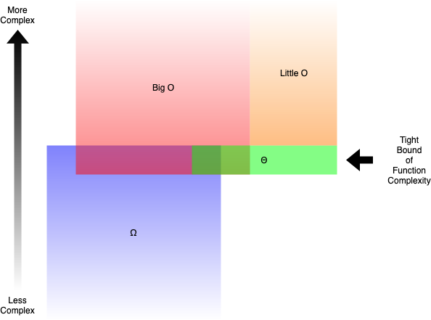
Big O (O()) describes the upper bound of the complexity.
Omega (Ω()) describes the lower bound of the complexity.
Theta (Θ()) describes the exact bound of the complexity.
Little O (o()) describes the upper bound excluding the exact bound.

Slide 60
Question: An image is represented by a 2D array of pixels. If you use a nested for loop to iterate through every pixel (that is, you have a for loop going through all the columns, then another for loop inside to go through all the rows), what is the time complexity of the algorithm when the image is considered as the input?
It was actually meant to be a trick question to test your understanding. The question tries to make you answer O(n²) because there is a nested for loop. However, n is supposed to be the input size. Since the image array is the input, and every pixel was iterated through only once, the answer is actually O(n)

Slide 61
Write a nested summation to express the number of times the loop body is executed.
for (i=0; i<=n-1; i++){
for (j=i+1; j<=n-1; j++){
loop body
}
}
The number of times the loop body is executed is:
n-1 n-1 n-1
----- ----- -----
\ \ \
\ \ 1 = \ (n-1) - (i+1) + 1
/ / /
/ / /
----- ------ -----
i=0 j = i+1 i=0
Since (n-1) - (i+1) + 1 = (n-1) - i we get that the number of times the loop
body is executed is: (n-1) + (n-2) + ... + 0 = n(n-1)/2 = n^2/2 - n/2
Hence the time complexity is Theta(n^2).

Slide 62
Optional (Good for COSC3320)

Slide 63
big-oh, big-theta, big-Omega
Is T1(n) = O(T2(n))?, Is T1(n) = Omega(T2(n))?, Is T1(n) = Theta(T2(n))?
A1 with time complexity T1(n) and A2 with time complexity T2(n
In all of the below lim is used for the limit as n approaches infinity:
6n^2
lim -------- = 0
(n^2) log n
Hence (n^2) log n is asymptotically faster growing than 6n^2. Thus
6n^2 = O(n^2 log n), 6n^2 != Omega(n^2 log n), 6n^2 != Theta(n^2 log n)
A1 is the faster algorithm.
T1(n) = 6n^2, T2(n) = n^2 log n

Slide 64
T1(n) = 3/2 n^2 + 7n -4, T2(n) = 8n^2
In all of the below lim is used for the limit as n approaches infinity:
3/2 n^2 + 7n - 4 3n + 7 3
lim ---------------- = lim ----------- = lim ---- = 3/16
8n^2 16 n 16
Hence these two functions grow at the same asymptotic growth rate, though
T1 has the smaller constant. Thus
T1(n) = O(T2(n)), T1(n) = Omega(T2(n)) and T1(n) = Theta(T2(n))
A1 is the faster algorithm since T1 has the smaller constant.

Slide 65
T1(n) = n^4, T2(n) = (n^3) log n
In all of the below lim is used for the limit as n approaches infinity:
n^4
lim -------- = infinity
n^3 log n
Hence n^4 is asymptotically faster growing. Thus
n^4 != O(n^3 log n), n^4 = Omega(n^3 log n), n^4 != Theta(n^3 log n)
A2 is the faster algorithm.

Slide 66
True /False
We prove this is true. To prove If p then q we assume p is true and show
that q must follow. Thus we assume that f(n) = Omega(g(n)). By the definition
of Omega we have that constants c and n_0 exists such that
f(n) >= c g(n) for all n >= n_0 (*)
We must show that there exists constants n'_0 and c' for which
g(n) <= c' f(n) for all n >= n'_0
Solving for f(n) in the above, we get the equivalent requirement that
f(n) >= 1/c' g(n) for all n >= n'_0
By letting 1/c' = c (so let c' = 1/c) and n'_0 = n_0 this is clearly true
since it is the same as the equation marked by a (*)
If f(n) = O(g(n)) then g(n) = O(f(n))
This is false as demonstrated by the counterexample, f(n)=n and g(n)=n^2.
Note that n = O(n^2) but n^2 != O(n).
f(n)+g(n) = O(max(f(n),g(n)))
We prove this is true. The key observation is that
f(n) + g(n) <= 2 max(f(n) + g(n)) for all n
Thus by letting n_0 = 1 and c = 2 we get the required conditions to have
that f(n) + g(n) = O(max(f(n),g(n))
If f(n) = Omega(g(n)) then g(n) = O(f(n))

Slide 67
3 n^2 + 10 n log n = O(n log n)
False, since n^2 (the dominate term on the left) is asymptotically faster growing than n log n and hence not upperbounded by it
(b) 3 n^2 + 10 n log n = Omega(n^2)
True, since n^2 (the dominate term on the left) asymptotically grows like n^2 and hence it is Omega(n^2)
(c) 3 n^2 + 10 n log n = Theta(n^2)
True, since n^2 (the dominate term on the left) asymptotically grows like n^2 and hence it is Theta(n^2). faster growing than n log n and hence not upperbounded by it
(d) n log n + n/2 = O(n)
False since n log n (the dominate term on the left) is not asymptotically upperbounded by n.
(e) 10 SQRT(n) + log n = O(n)
True, since the dominate term on the left, 10 SQRT(n), is asymptotically upperbounded by n.
(f) SQRT(n) + log n = O(log n)
False, since the dominate term on the left, SQRT(n), is not asymptotically upperbounded by n. Note that that lim as n -> infinity of log n / SQRT(n) = 0 giving that SQRT(n) is asymptotically faster growing.

Slide 68
(g) SQRT(n) + log n = Theta(log n)
False, since the dominate term on the left, SQRT(n), is not asymptotically upperbounded by n.
(h) SQRT(n) + log n = Theta(n)
False, since the dominate term on the left, SQRT(n), is asymptotically faster slower growing than n.
2 SQRT(n) + log n = Theta(SQRT(n))
True, since the dominate term on the left, 2 SQRT(n), grows asymptotically at the same rate as SQRT(n).
(j) SQRT(n) + log n = Omega(1)
True, since the dominate term on the left, SQRT(n), is asymptotically faster growing than 1.
(k) SQRT(n) + log n = Omega(log n)
True, since the dominate term on the left, SQRT(n), is asymptotically faster growing than log n
(l) SQRT(n) + log n = Omega(n)
False, since the dominate term on the left, SQRT(n), is asymptotically slower growing than n

Slide 69
float useless(A){
n = A.length;
if (n==1){
return A[0];
}
let A1,A2 be arrays of size n/2
for (i=0; i <= (n/2)-1; i++){
A1[i] = A[i];
A2[i] = A[n/2 + i];
}
for (i=0; i<=(n/2)-1; i++){
for (j=i+1; j<=(n/2)-1; j++){
if (A1[i] == A2[j])
A2[j] = 0;
}
}
b1 = useless(A1);
b2 = useless(A2);
return max(b1,b2);
}
Clearly T(1) = Theta(1). The first loop used for splitting has time complexity
Theta(n) and the second has time complexity Theta(n^2).
There are 2 recursive calls of size n/2.
Finally constant time (Theta(1)) is spent combining. Hence we get the
recurrence.
T(1) = Theta(1)
T(n) = 2 T(n/2) + Theta(n^2) for n >= 2
By the master method we get that T(n) = Theta(n^2). Hence this given algorithm
is a Theta(n^2) algorithm.

Slide 70
T(n) = 2T(n/2) + cn, T(1)=1 for n >= 0 a power of 2
T(n) = c n log_2 n + n
We are going to exactly solve this recurrence when n is a power of 2.
There are log_2 n levels above the leaves each of which uses cn statements.
Finally there are n leaves that use 1 step each.
To prove it is correct (for n a power of 2) we use induction on k = 0,1,2,...
where n = 2^k. So the base case is that T(1)=1 by the definition and our
formula also gives 1 since log_2 1 = 0.
inductive step: Show if T(2^k) = c 2^k k + 2^k
then T(2^{k+1}) = c 2^{k+1} (k+1) + 2^{k+1}
Thus we assume that T(2^k) = c 2^k k + 2^k (this is our inductive hypothesis).
By the given definition that T(n) = 2 T(n/2) + cn we have that
T(2^{k+1}) = 2 T(2^k) + c 2^{k+1}
Then by applying the inductive hypothesis for T(2^k) and simplifying we get
the desired result that T(2^{k+1}) = c 2^{k+1} (k+1) + 2^{k+1}

Slide 71
T(n) = 4T(n/2) + cn, T(1)=1 for n >= 0 a power of 2
The number of leaves is 4^{log_2 n} = 2^{2 log_2 n} = 2^{log_2 n^2} = n^2
T(n) = (SUM_{i=0 to (log_2 n) - 1} cn 2^i) + n^2 T(1) = cn(2^{log_2 n} - 1) + n^2
= cn^2 - cn + n^2
= (c+1) n^2 - cn
To prove it is correct via induction follow the same structure as in 6a above.

Slide 72
T(n) = 2T(n/4) + sqrt(n), T(1)=1 for n >= 0 a power of 4
The number of leaves is 2^{log_4 n} = 4^{1/2 log_4 n} = 4 ^{log_4 n^{1/2}}
= sqrt(n)
T(n) = (SUM_{i=0 to (log_4 n) - 1} sqrt(n) + sqrt(n) T(1)
= sqrt(n) log_4 n + sqrt(n)
= sqrt(n) (log_4 n + 1)
To prove it is correct via induction follow the same structure as in 6a above
except you will let n = 4^k.

Slide 73
Example (iterative algorithm)

Slide 74
// Compute the maximum element in the array a.
Algorithm max(a):
max ← a[0]
for i = 1 to len(a)-1
if a[i] > max
max ← a[i]
return max
The time complexity, measured in the number of comparisons, then becomes T(n) = n - 1.

Slide 75
// Tell whether the array a contains x.
Algorithm contains(a, x):
for i = 0 to len(a)-1
if x == a[i]
return true
return false
Worst: If x isn’t found in a the algorithm makes n comparisons,
Best but if x equals a[0] there is only one comparison.
➔ BigO(n)

Slide 76
// Reverse the order of the elements in the array a.
Algorithm reverse(a):
for i = 1 to len(a)-1
x ← a[i]
for j = i downto 1
a[j] ← a[j-1]
a[0] ← x
the outer for loop is executed n - 1 times The time complexity therefore becomes
= 1 + 2 + … + (n - 1) = n(n - 1)/2 = n²/2 - n/2.
Algorithm reverse(a):
for i = 0 to n/2
swap a[i] and a[n-i-1]
Θ(n) time complexity

Slide 77
Time complexity of recursive functions

Slide 78
// Sum returns the sum 1 + 2 + ... + n, where n >= 1.
func Sum(n int) int {
if n == 1 {
return 1
}
return n + Sum(n-1)
}
T(1) = 1, (*)
T(n) = 1 + T(n-1), when n > 1. (**)
By repeatedly applying these relations, we can compute T(n) for any positive number n.
T(n) = (**)
1 + T(n-1) = (**)
1 + (1 + T(n-2)) = 2 + T(n-2) = (**)
2 + (1 + T(n-3)) = 3 + T(n-3) = …
k + T(n-k) = …
n - 1 + T(1) = (*)
n - 1 + 1= Θ(n)

Slide 79
// Find returns the smallest index i at which x <= a[i].
// If there is no such index, it returns len(a).
// The slice must be sorted in ascending order.
func Find(a []int, x int) int {
switch len(a) {
case 0:
return 0
case 1:
if x <= a[0] {
return 0
}
return 1
}
mid := 1 + (len(a)-1)/2
if x <= a[mid-1] {
return Find(a[:mid], x)
}
return mid + Find(a[mid:], x)
}
T(1) = 1, (*)
T(n) = 1 + T(n/2), when n > 1. (**)
The equation (**) captures the fact that the function performs constant work (that’s the one) and a single recursive call to a slice of size n/2.
Once again, it’s possible to find a solution by repeated substitution.
T(n) = (**)
1 + T(n/2) = (**)
1 + (1 + T(n/4)) = 2 + T(n/4) = (**)
2 + (1 + T(n/8)) = 3 + T(n/8) = ...
k + T(n/2k) = ...
log n + T(n/2log n) = log n + T(1) = (*)
log n + 1 = Θ(log n).

Slide 80
Fun Example of multiplication
Karatsuba’s algorithm was proposed in 1960. The Toom-Cook algorithm (1963 and 1966) works similarly but reduces 9 multiplications to 5, instead of 4 to 3. This runs in time about n^(1.465). The Schönhage–Strassen algorithm (1971) works in time O(nlog(n)loglog(n)) using FFT-like stuff. The state-of-the-art (in theory, not in practice) is Furer’s algorithm (2007), which runs in time O(n*log(n)* 2^(\log^*(n))).

Slide 81
Divide and conquer
Break problem up into smaller (easier) sub-problems
Big problem
Smaller problem
Smaller problem
Often recursively!
Yet smaller problem
Yet smaller problem
Yet smaller problem
Yet smaller problem

Slide 82
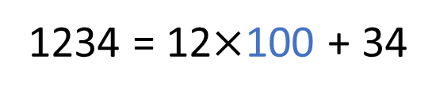
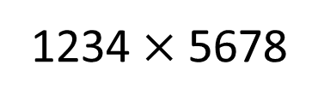
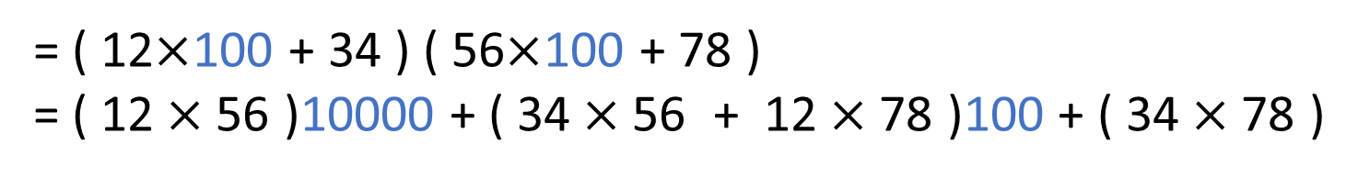
Divide and conquer for multiplication
Break up an integer:
1234 = 12$×$100 + 34
1234$×$5678
= ( 12$×$100 + 34 ) ( 56$×$100 + 78 )
= ( 12$×$56 )10000 + ( 34$×$56 + 12$×$78 )100 + ( 34$×$78 )
1
2
3
4
One 4-digit multiply
Four 2-digit multiplies

Slide 83
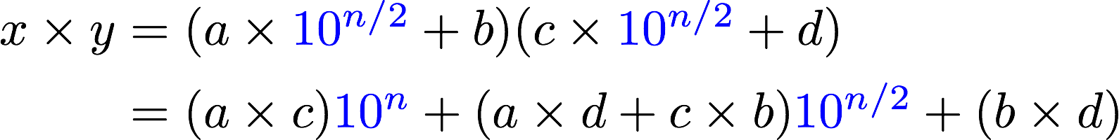
More generally
Break up an n-digit integer:
1
2
3
4
One n-digit multiply
Four (n/2)-digit multiplies
Notes:
For example,
12345678 = 1234 * 10^4 + 5678
Here, n = 8, and the 4 in 10^4 is 4 = 8/2
(Write xy = (a 10^(n/2) + b) * (c 10^(n/2) + d) on the board and keep it there)

Slide 84
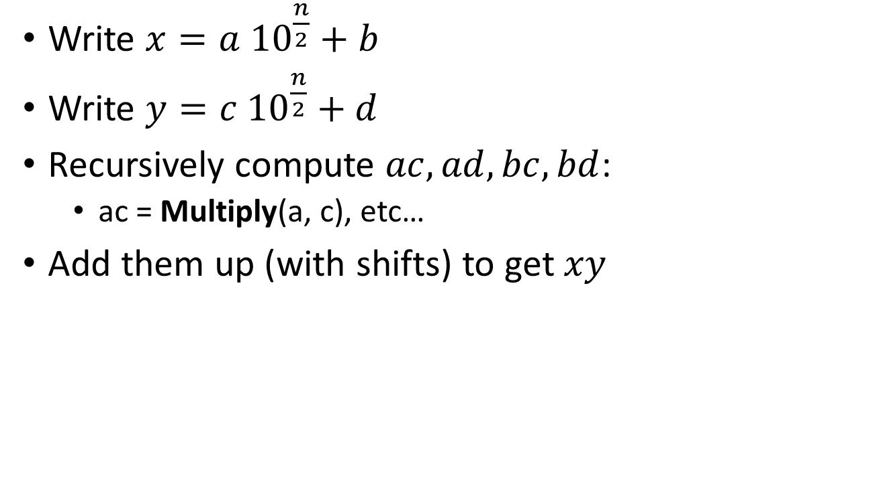
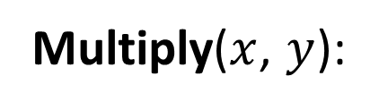
Divide and conquer algorithm
x,y are n-digit numbers
Base case: I’ve memorized my 1-digit multiplication tables…
Multiply($x$, $y$):
Write $x=a {10}^{\frac{n}{2}}+b$
Write $y=c {10}^{\frac{n}{2}}+d$
Recursively compute $ac, ad,bc,bd$:
ac = Multiply(a, c), etc…
Add them up (with shifts) to get $xy$
a, b, c, d are
n/2-digit numbers
Not very precise pseudocode…
Questions about the algorithm?
How long does this take?
Better or worse than the grade-school algorithm?
Notes:
Ask: what's missing?

Slide 85
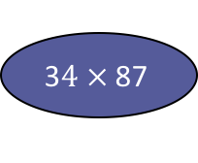
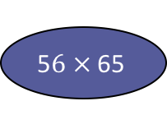
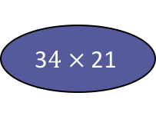
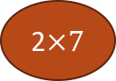
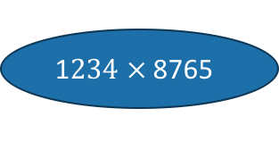

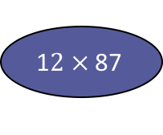
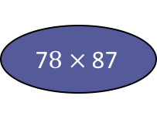
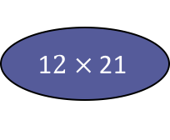
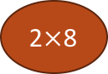
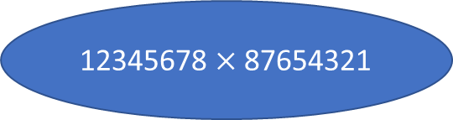
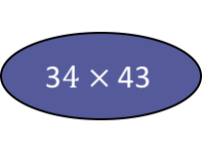
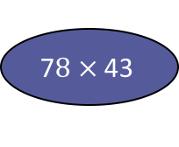
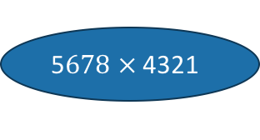
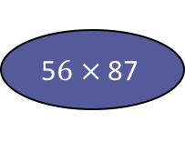
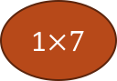
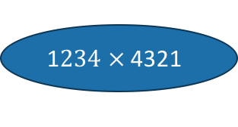
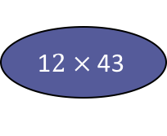
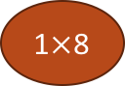
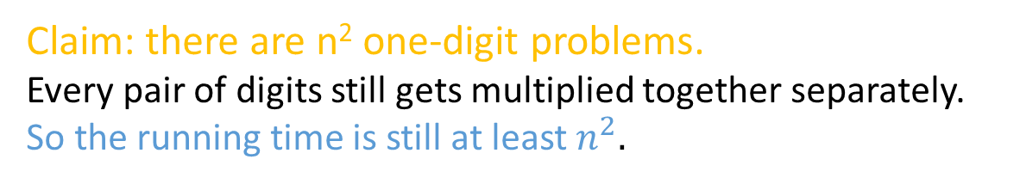
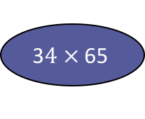
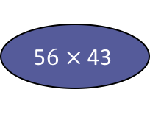
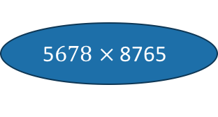
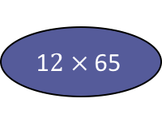
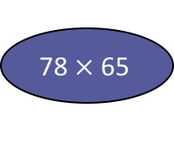
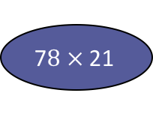
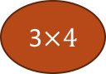
Let’s do an example
How many one-digit multiplies?
12345678 $×$ 87654321
1$234 ×$ 8765
5$678 ×$ 8765
1$234 ×$ 4321
5$678 ×$ 4321
1$2 ×$ 87
5$6 ×$ 87
1$2 ×$ 43
5$6 ×$ 43
3$4 ×$ 87
7$8 ×$ 87
3$4 ×$ 43
7$8 ×$ 43
1$2 ×$ 65
5$6 ×$ 65
1$2 ×$ 21
5$6 ×$ 21
3$4 ×$ 65
78$×$ 65
3$4 ×$ 21
7$8 ×$ 21
…
3$×4$
…
1$×$8
1$×7$
2$×$8
Claim: there are n² one-digit problems.
Every pair of digits still gets multiplied together separately.
So the running time is still at least $n^{2}.$
2$×7$
etc...

Slide 86
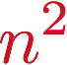
Another way to see this*
*we will come back to this sort of analysis later and still more rigorously.
1 problem
of size n
If you cut n in half log₂(n) times, you get down to 1.
So we do this log₂(n) times and get…
4^{log_2(n)} = n²
problems of size 1.
4 problems
of size n/2
4^{t} problems
of size n/2^{t}
…
What about the work you actually do in the problems?
____ problems
of size 1
Notes:
How many leaves? At level t, I have 4^t nodes. So I have 4^(depth of tree) nodes.
What is the depth of the tree? It's how many times I need to cut n in half to get down to 1.
There's a name for that, it's log_2(n). So I get
4^(log_2(n)) = 2^(2 * log_2(n)) = (2^log_2(n))^2 = n^2.

Slide 87
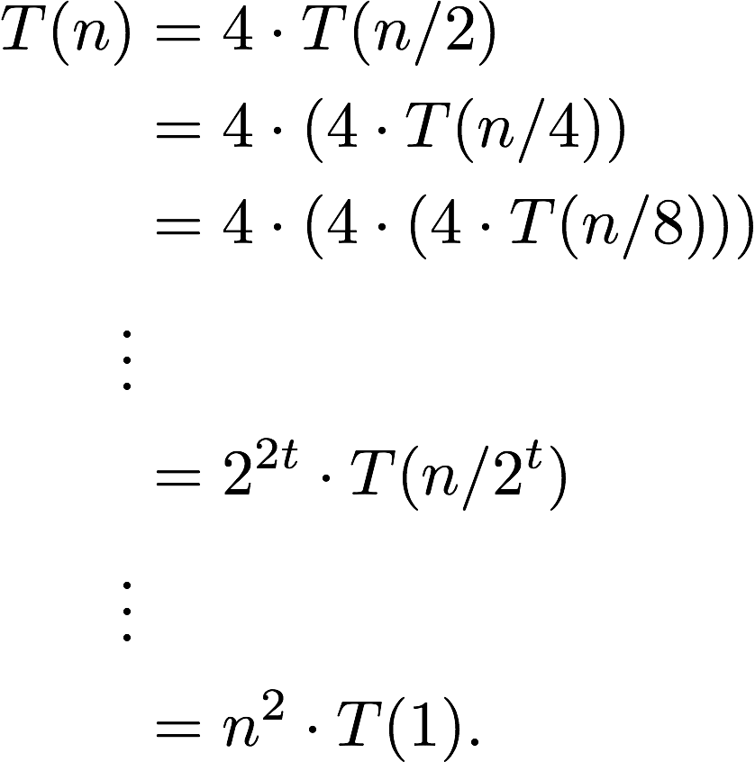
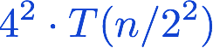
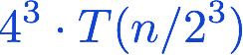
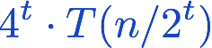
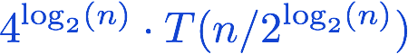
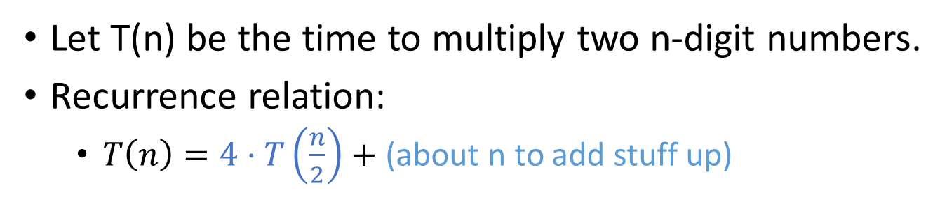
Yet another way to see this*
Let T(n) be the time to multiply two n-digit numbers.
Recurrence relation:
$T\left(n\right)=4⋅T\left(\frac{n}{2}\right)+$ (about n to add stuff up)
Ignore this term for now…

Slide 88
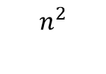
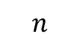
That’s a bit disappointing All that work and still n²…
$$n^{2}$$
But wait!!
$$n$$

Slide 89
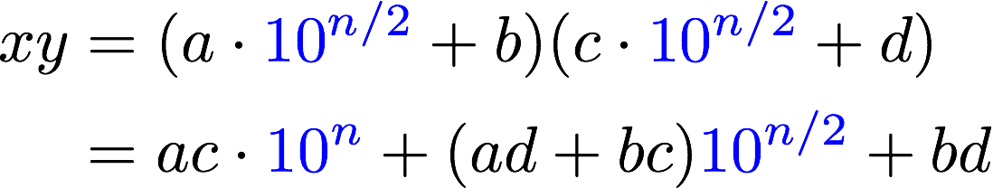
Divide and conquer can actually make progress
Karatsuba figured out how to do this better!
If only we recurse three times instead of four…
Need these three things
Notes:
(This expression should still be on the board from before -- if not, write it again)

Slide 90
Karatsuba integer multiplication
Recursively compute
ac
bd
(a+b)(c+d)
Subtract these off
get this
(a+b)(c+d) = ac + bd + bc + ad
Assemble the product:
✓
✓
✓

Slide 91
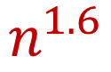
What’s the running time?
1 problem
of size n
If you cut n in half log₂(n) times, you get down to 1.
So we do this log₂(n) times and get…
3^{log_2(n)} = n^{log_2(3)} = n^{1.6}
problems of size 1.
3 problems
of size n/2
3^{t} problems
of size n/2^{t}
…
$$n^{1.6}$$
____ problems
of size 1

Slide 92
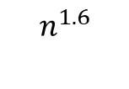
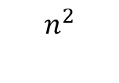
This is much better! (Can we do better still?)
$$n^{2}$$
$$n^{1.6}$$
$$n$$

